Slide 1
Exercices

Slide 2
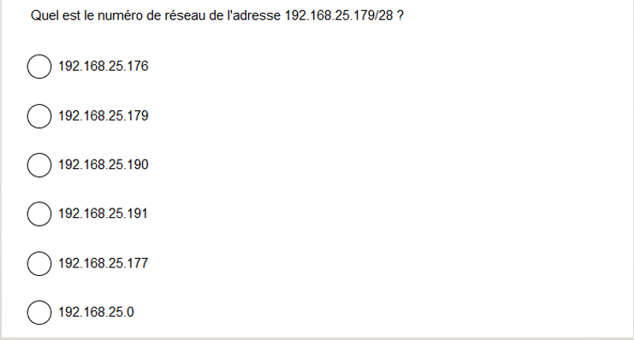
Q21
11000000.10101000.00011001.10110001
11111111.11111111.11111111.11110000 masque
--------------------------------------------------- (et logique)
11000000.10101000.00011001.10110000
192.168.25.176

Slide 3
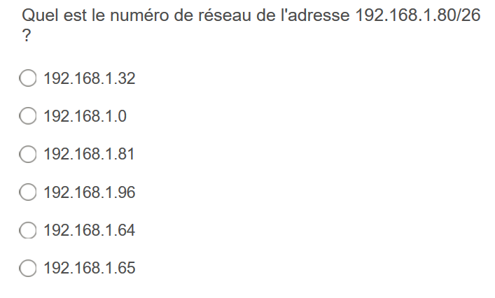
Q35

Slide 4
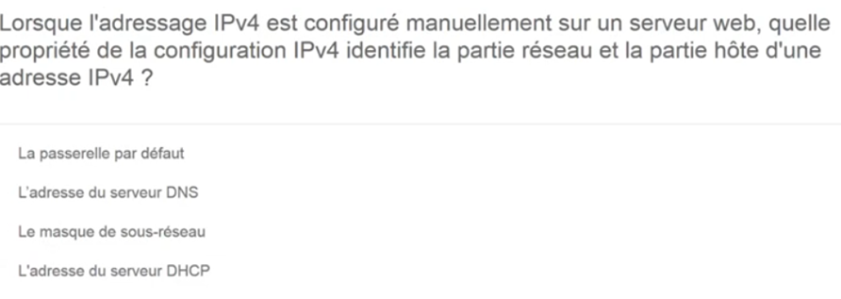
Q43

Slide 5
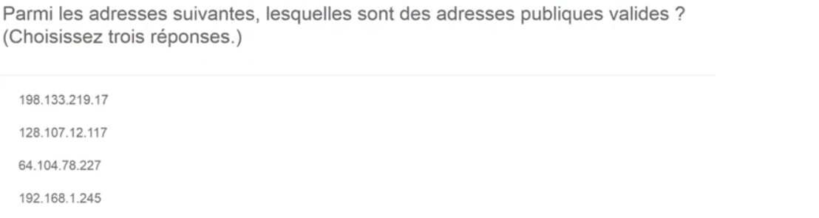
Q5

Slide 6
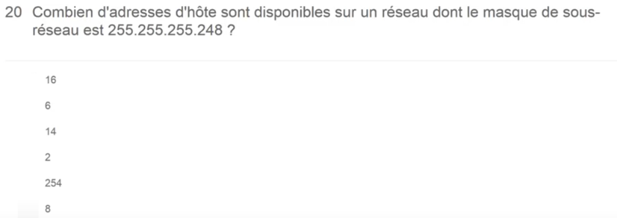
Q66

